Slide 1
Linear Regression Lines (Part 1)
Instructor: Hamed Hasheminia
Lecture 4

Slide 2
Agenda
What are linear regression lines?
Explore single variable regression lines
Explore multi-variable regression lines
How to capture non-linearity with linear regression lines
Learn how to interpret regression coefficients
How to deal with dummy variables
Lab
Use sklearn library

Slide 3
Linear Regression Lines
Linear regression is a simple approach to supervised learning. It assumes that the dependence of Y (Your quantitative output) on X₁,X₂, …., X_{p} (your inputs) is linear
Linear Regression Lines are:
Simple to explain
Highly interpretable
Model training and prediction are fast
No tuning is required (excluding regularization)
(Input) Features don't need scaling
Can perform well with a small number of observations
Well-understood
Not too flexible

Slide 4


Simple Linear regression Using a single predictor
We assume a model
Where beta0 and beta1 are two unknown constants that represent the intercept and slope, also known as coefficients or parameters and epsilon is the error term.
Gove some estimates for the model coefficients, we predict y using:
Y_hat indicates a prediction of Y on the basis of X = x. The hat symbol denotes an estimated value.

Slide 5
Linear Regression for the advertising data
Consider the advertising data we worked on last session:
Questions we might ask:
Is there a relationship between advertising budget and sales?
How strong is the relationship between advertising budget
band sales?
Which media does contribute to sales the most?
How accurately can we predict future sales?
How good does our linear model perform?
Is there synergy among the advertising media? (We talk about this next session)

Slide 6
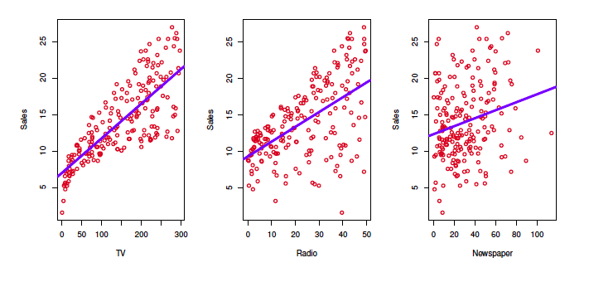
Advertising Data

Slide 7



Estimation of the parameters by least squares
Let be the prediction for Y based on the i^{th} value of X. Then represents the i^{th} residual.
We define the residual sum of squares (RSS) as
Or equivalently as
The least square approach chooses and to minimize the RSS.

Slide 8
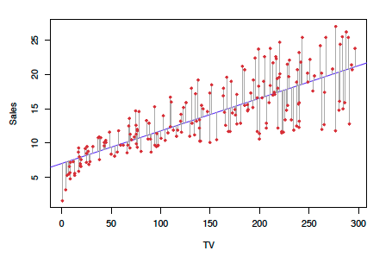
Example: Advertising Data
The least squares fit for the regression of Sales onto TV.
In this case linear fit captures the essence of the relationship, although it is somewhat deficient in the left of the plot.

Slide 9
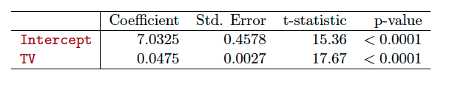
Results for the advertising Data

Slide 10
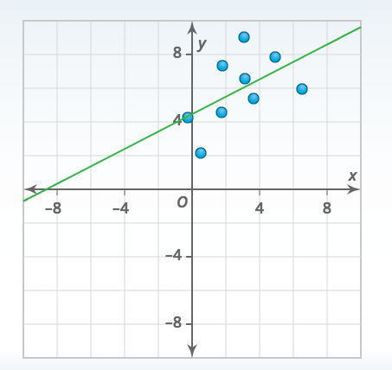
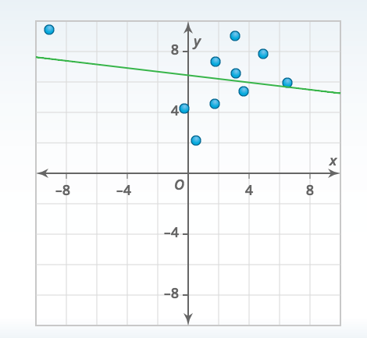
The effect of outliers on Regression lines

Slide 11

Multiple Linear Regression
Here is our model is
We interpret Beta_j as the average effect on Y of a one unit increase in X_{j}, holding other predictors fixed. In the advertising example, the model becomes

Slide 12
Interpreting regression coefficients
The ideal scenario is when the predictors are uncorrelated
- A balanced design
Each coefficient can be estimated and tested separately.
Interpretations such as “a unit change in X_{j} is associated with a Beta_j change in Y , while all the other variables stay fixed”, are possible.
Correlations amongst predictors cause problems:
The variance of all coefficients tends to increase, sometimes dramatically.
Interpretations become hazardous – when X_{j} changes, everything else changes.
Claims of causality should be avoided for observational data.

Slide 13
The woes of (interpreting) regression coefficients
“Data analysis and regression” Mosteller and Tukey 1977
A regression coefficient Beta_j estimates the expected change in Y per unit change in X_{j}, with other predictors held fixed. But predictors usually change together.
Example: Y = Number of tackles by a football player in a season; W and H are his weight and height. Fitted regression model is:
How do we interpret -0.1?
“Essentially, all models are wrong, but some are useful” George Box
“The only way to find out what will happen when a complex system is distributed is to disturb the system, not merely to observe it passively.” Fred Mosteller and John Tukey, paraphrasing George Box

Slide 14



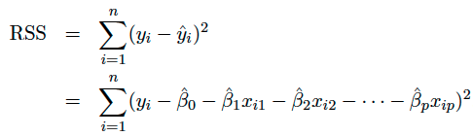
Estimation and Prediction for Multiple Regression
Given Estimates we can make predictions using the formula
We estimate as the values that minimize the sum of squared residuals
This is done using any standard statistical software.

Slide 15
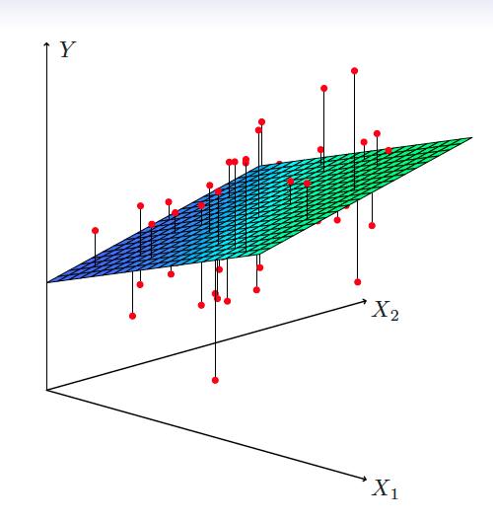

Slide 16
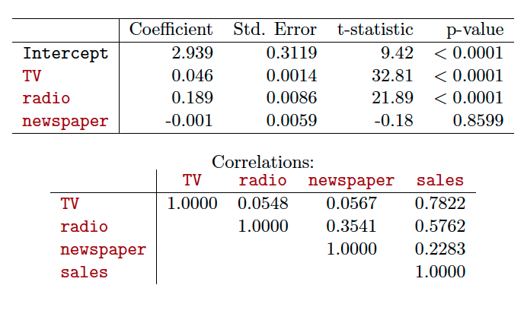
Results for advertising data

Slide 17

Some important Questions
Is at least one of the predictors useful in predicting the response?
Do all the predictors help to explain Y, or is only a subset of the predictors useful?
How well does the model fit the data?
Given a set of predictor values, what response value should we predict, and how accurate is our prediction?

Slide 18
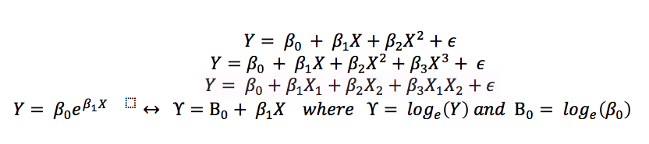
Linear Regression Models – adding non-linear terms

Slide 19

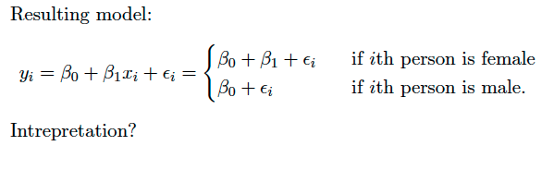
Qualitative Predictors
Example: Let’s investigate differences in credit card balances between males and females.
Our output, Y, is credit card balance
We assume we only want to use gender as a predictor
We create a new variable:

Slide 20
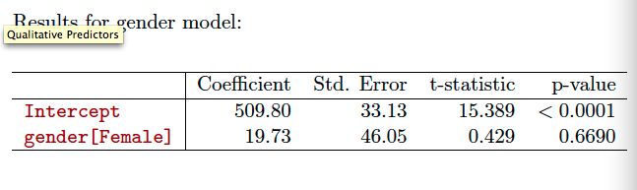
Let’s interpret the results

Slide 21
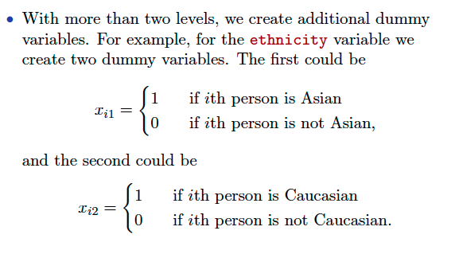
Qualitative predictors with more than two levels

Slide 22
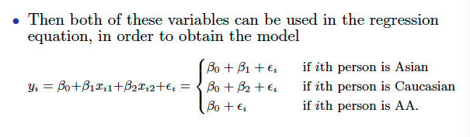
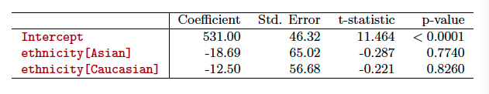
Dummy Variables and Results for ethnicity

Slide 23
Summary
We learned:
What are regression lines – advantages and limitations
Single variable and multi-variable regression lines
How to interpret coefficients of regression lines
Different classes of non-linear functions that can be handled using regression lines.
Using dummy variables – how to interpret dummy variables
What we are going to learn next session:
Hypothesis test – test of significance on regression coefficients
P-Value
Different types of error
Interaction effects

Slide 24
Python - sklearn library
Before leaving class – please make sure you have sklearn library. Type “import sklearn” on your ipython notebook. If it runs, perfect, otherwise, you need to install sklearn on your computer.
To install sklearn library type “conda install scikit-learn” on your terminal window/command line
Also, please check if you have seaborn package.
If not type “conda install seaborn” on your terminal window/command line

